Slide 1
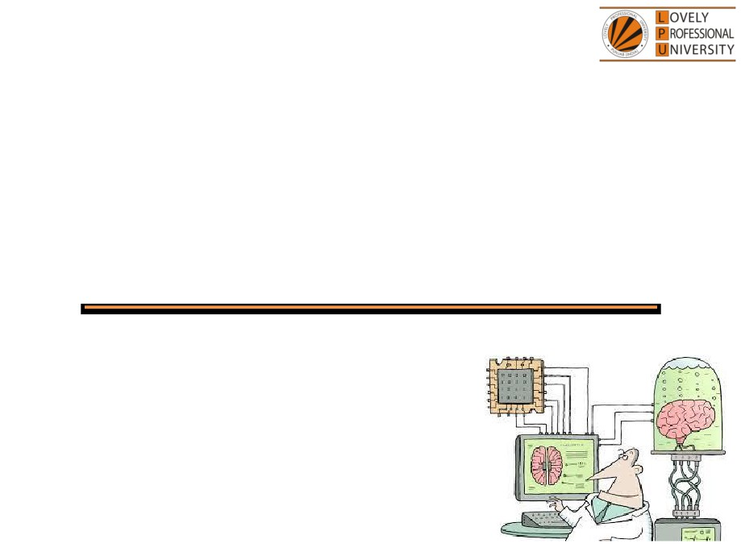
PEA305
Analytical Skills I
Lecture #0
Breaking the ice
Department of Analytical Skills

Slide 2

Course Details
LTP - 2 1 0 [Two lectures, One Tutorial per week]
Text Book
Analytical Skills I
Reference Book
Quantitative Aptitude by M Tyra
Quantitative Aptitude by Abhijit Guha

Slide 3
Course Assessment Model
Marks break up
• Attendance
15
• CA
30
• MTE (MCQ)
15
• ETE (MCQ)
40
• Total
100
• MTE & ETE to be done on OMR sheets
All tests will be based on MCQ.

Slide 4

Course Outcomes
CO1 :: apply the procedural fluency with number system and mathematical operations to solve the stated problems
CO2 :: determine an appropriate approach to solve problems related to percentage and profit & loss
CO3 :: analyze the data given and interpret the number and alphanumeric series
CO4 :: use the analytical concepts learnt to solve the questions of ratio and proportion
CO5 :: apply the concepts of permutation, combination and probability to solve related problems
CO6 :: analyze the reasoning aptitude problems such as blood relation and direction sense to solve related problems

Slide 5
Course focus identification
Employability

Slide 6
Assessment and Evaluation Model
Assessment (Category) | Conducted Week
CA 1 (A0303) | Week 5 (Duration 50 Min Q 30)
MTE (11A) | After week 7 (Duration 60 Minutes Q 40)
CA 2 (A0303) | Week 10 (Duration 50 Min Q 30)
CA 3 (A0303) | Week 14 (Duration 50 Min Q 30)
ETE (11A) | After week 14 (Duration 120 Min Q 80)

Slide 7
Pedagogical initiative
Week | Competitive event
6th | Apti Ninja- An event based on logical puzzles
7th | Expeditious Symposium - An Event based on Rapid Analytical Testing
14th | Sementic analogy- Competitive event based on different types of analogy questions
Week | Workshops
3rd | Inference-A workshop on counting of figures
4th | Ratiocinate-A workshop on reasoning ability
11th | Interpretation - A workshop on Arrangements of blocks
Foundation classes- Week 7th and 14th

Slide 8
Innovative evaluation strategies
Evaluation | Conduct
CA 1 | External
MTE | External
CA 2 | External
CA 3 | External
ETE | External

Slide 9
Unit wise course content
Unit I
Vedic maths : fast calculation techniques
Number system : classification of numbers, divisibility rules, factorials, unit digit calculation, number of factors, remainder theorems, HCF & LCM
Average : average calculations, inclusion and exclusion, weighted average
Unit II
Percentage : calculation of percentages, percentage comparison, percentage to fraction conversion, successive percentage change, problems based on marks, election, population and percentage error
Profit loss discount : concept of cost price, selling price and marked price, calculations of profit and loss percentage, problems on discount, faulty weights, number of articles, and common selling price
Simple and compound interest : concept of interest calculation, comparison of simple and compound interest, compounding based problems on depreciation and growth
Unit III
Logical reasoning : number series, alphabet series, alphabet test, alphanumeric series, coding and decoding, language coding

Slide 10
Unit IV
Ratio and proportions : concept of ratio and proportion, problems based on ages and partnership
Alligation and mixtures : concept based question of alligation and mixtures, replacement based questions
Unit V
Permutation and combination : principles of counting, problems based on selection, arrangement, numbers, words, rank and distribution, geometric application, circular arrangement
Probability : concept of probability, classification of events, problems based on coins dices and cards, conditional probability
Unit VI
Analytical reasoning : blood relations, direction sense test

Slide 11


Let us look around…
Why every organization takes Quantitative Aptitude Tests before hiring any future employee…

Slide 12
Right Decision Making
Mental Alertness
Ability to quickly interpret data
Establish logical relationship
Arrive at the correct conclusions
Make the right judgment

Slide 13
Organizations recruit people who have
Quick Mental Abilities.
PEA502 Analytical Skills-II :: Vishal Ahuja

Slide 14
How you will make your mental ability Quick…!!!
Quick = Tricks
PEA502 Analytical Skills-II :: Vishal Ahuja

Slide 15
123456^654321
Find the unit digit

Slide 16
And What about this….?
In how many ways the committee of 5 members be formed out of 7?

Slide 17

5 minute…???
10 minutes…???
15 minutes…???
20 minutes…???
Again…!!! It will not take more than 30 SECONDS.

Slide 18

A person invested a sum of Rs.750 in a bank at simple interest. After 5 years he received Rs.1200. Find the rate of interest offered by the bank.
What do we need to know?

Slide 19
What do we need to know?
This course PEA305 : Analytical Skills-I
Ability to efficiently solve the company specific Quantitative
Aptitude Tests.
Ability to prioritize and manage Time.
Ability to efficiently analyze data.

Slide 20


Next Topic: Vedic Maths

